Slide 1
Encryption and Decryption Using Digital Cryptography in Files
Mentor name: Mrs. Neha Tripathi
Presented by: Shruti Agarwal

Slide 2
Introduction
This project focuses on using steganography to hide and retrieve data from files (e.g., images) with Django backend and modern frontend technologies.
The primary goal is to create a web-based solution that can perform encryption and decryption of hidden data in image files, utilizing digital cryptography and steganography techniques.

Slide 3
Problem Statement
There is an increasing need to securely transmit data. Current encryption techniques are vulnerable to detection. This project addresses the challenge of hiding data within digital files (like images), making it difficult to detect the presence of hidden data.

Slide 4
Methodology
Frontend: HTML5, CSS3, JavaScript with Bootstrap and Tailwind CSS for responsive design.
Backend: Django to manage file uploads, data processing, and user interactions.
Encryption: LSB steganography method to hide data within image pixels.
Decryption: Reverse extraction of data from the steganography-modified images.
Testing: Unit testing for encryption, decryption, and overall application functionality.

Slide 5
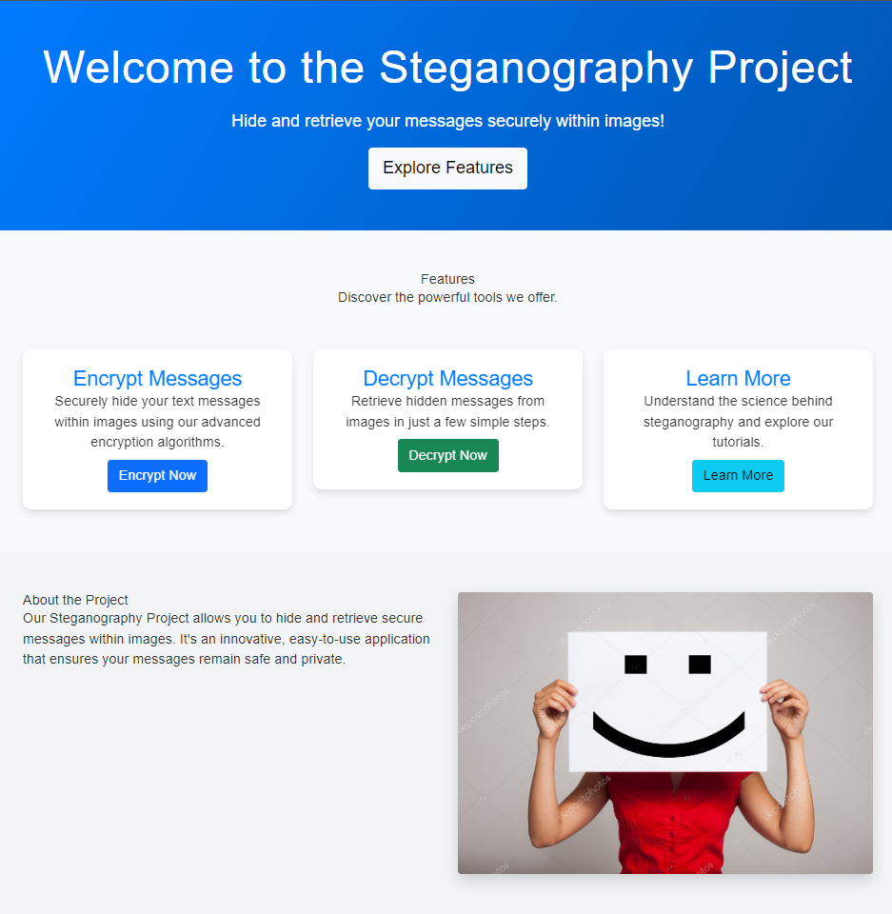
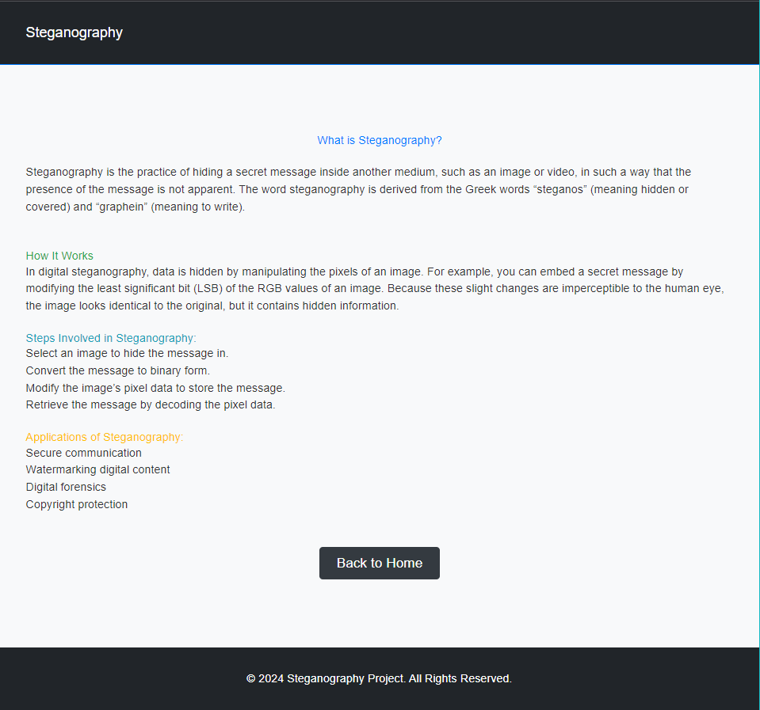
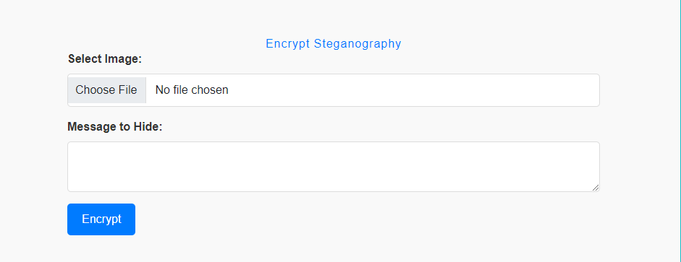
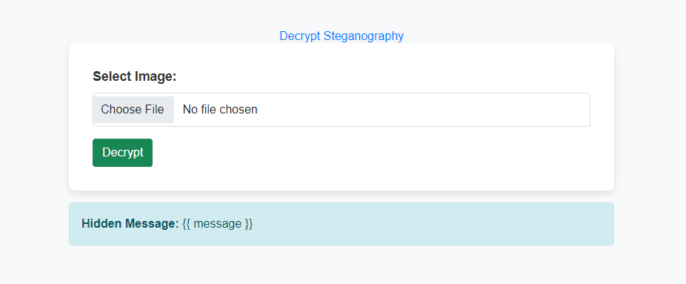
Output
Learn
Encrypt
Decrypt

Slide 6



Chart
Frameworks CDN (Bootstraps, Tailwind CSS)
User Image Input
Image Uploaded to the server
Frontend
(Html, CSS and JavaScript)
Image Output
Server (LSB and Django)

Slide 7
RESULT
1. Successfully integrated a full stack solution for secure data hiding using steganography.
2. Built an encryption and decryption system that supports images in .png, .jpeg formats.
3. Provided a user-friendly interface that allows non-technical users to encrypt and decrypt files with ease.
4. Ensured scalability and extendibility for future use cases (e.g., support for video file steganography).

Slide 8
Challenges
1. Handling large image file uploads while maintaining optimal performance.
2. Ensuring accuracy in data extraction from steganography-modified images.
3. Maintaining responsive UI for both mobile and desktop views while processing files.
4. Overcoming the complexity of integrating cryptography with steganography techniques.

Slide 9
Learnings
1. Deepened understanding of steganography, specifically LSB encryption techniques.
2. Gained practical experience with Django for managing file operations and user input.
3. Improved knowledge of integrating frontend and backend technologies to build full stack applications.
4. Enhanced skills in testing algorithms for cryptographic and steganographic functionality.

Slide 10
Conclusion and Future Recommendations
This project highlights the potential of digital cryptography for secure data transmission using steganography in common file formats like images. Future improvements include:
Adding steganography support for video files.
Implementing user authentication and role-based access.
Enhancing UI/UX, especially for mobile users.
Integrating Django REST Framework (DRF) for API access.
Extending support to more file types.

